Slide 1
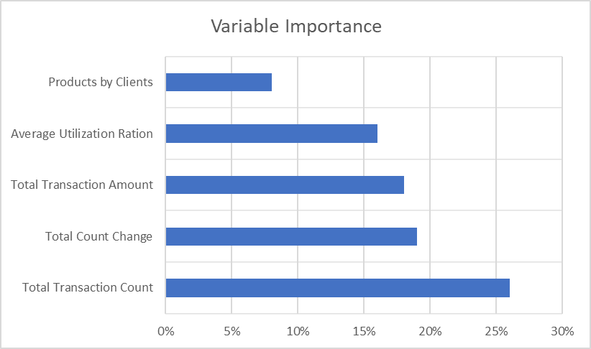
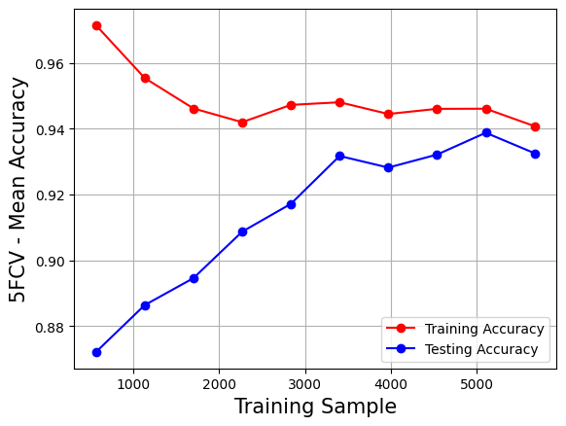
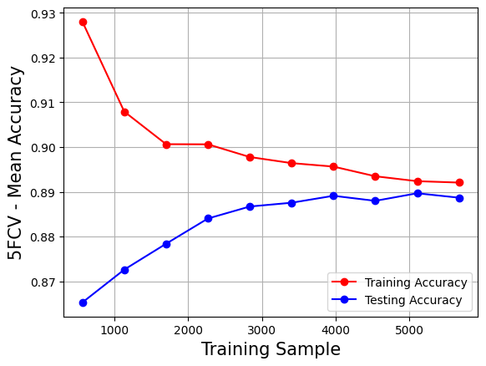
Presentation 3: Why Customers Are Leaving
Data Cleaning
Client Attrition
Accuracy Rates, AUC, Important Variables
Learning Curves
Performed Missing Value Analysis
Performed Imputation and used the median to fill in missing data
Performed Multicollinearity to see if there is any correlation in the variables
Removed Colinear variables if they were greater than 70% correlated
Removed Near-Zero Variance variables as they do not impact the models that much
Performed Standardization on the data
Partitioned data into 70% training and 30% testing
Client Attrition is a metric for keeping track of what customers are leaving. “YES” means the account is closed.
MLP was the “best” model based on the AUC
MLP
Client Attrition | Income (<40K)
NO | 39%
YES | 43%
Total Transaction Count is the most
RF was the “worst” model based on the AUC
Model | Accuracy Rate | AUC
MLP | 94% | 87%
SVM | 93% | 75%
RF | 89% | 73%
KNN | 89% | 81%
LR | 89% | 65%
important variable for RF and DT and would be the best variable to use to predict Client Attrition.
We want to focus on clients that make less than 40K as they make up most customers that are closing accounts and going elsewhere.
RF
Client Attrition | Married
NO | 50%
YES | 47%
Variables | Percent Missing
Total_Revolving_Bal | 25%
Education_Level | 15%
Income_Category | 11%
Marital_Status | 7%
Credit_Limit | 0.3%
Summary:
Looking at the different models, MLP would be the best one to use to predict Client Attrition as it has the highest accuracy rate and the highest AUC. We recommend the bank manager use the MLP model to predict their customers that are leaving. They can also use RF model to predict customers leaving but need to use Total Transaction Count.
MLP and SVM are the best to use to predict Client Attrition based on accuracy rates.
MLP and LR are the best to predict Client Attrition based on the ROC Curve
We also want to focus on those that are married as they make up most customers that are leaving.

